Slide 1

Git & GitHub Commands – Practical Guide
A beginner-friendly introduction to version control essentials

Slide 2
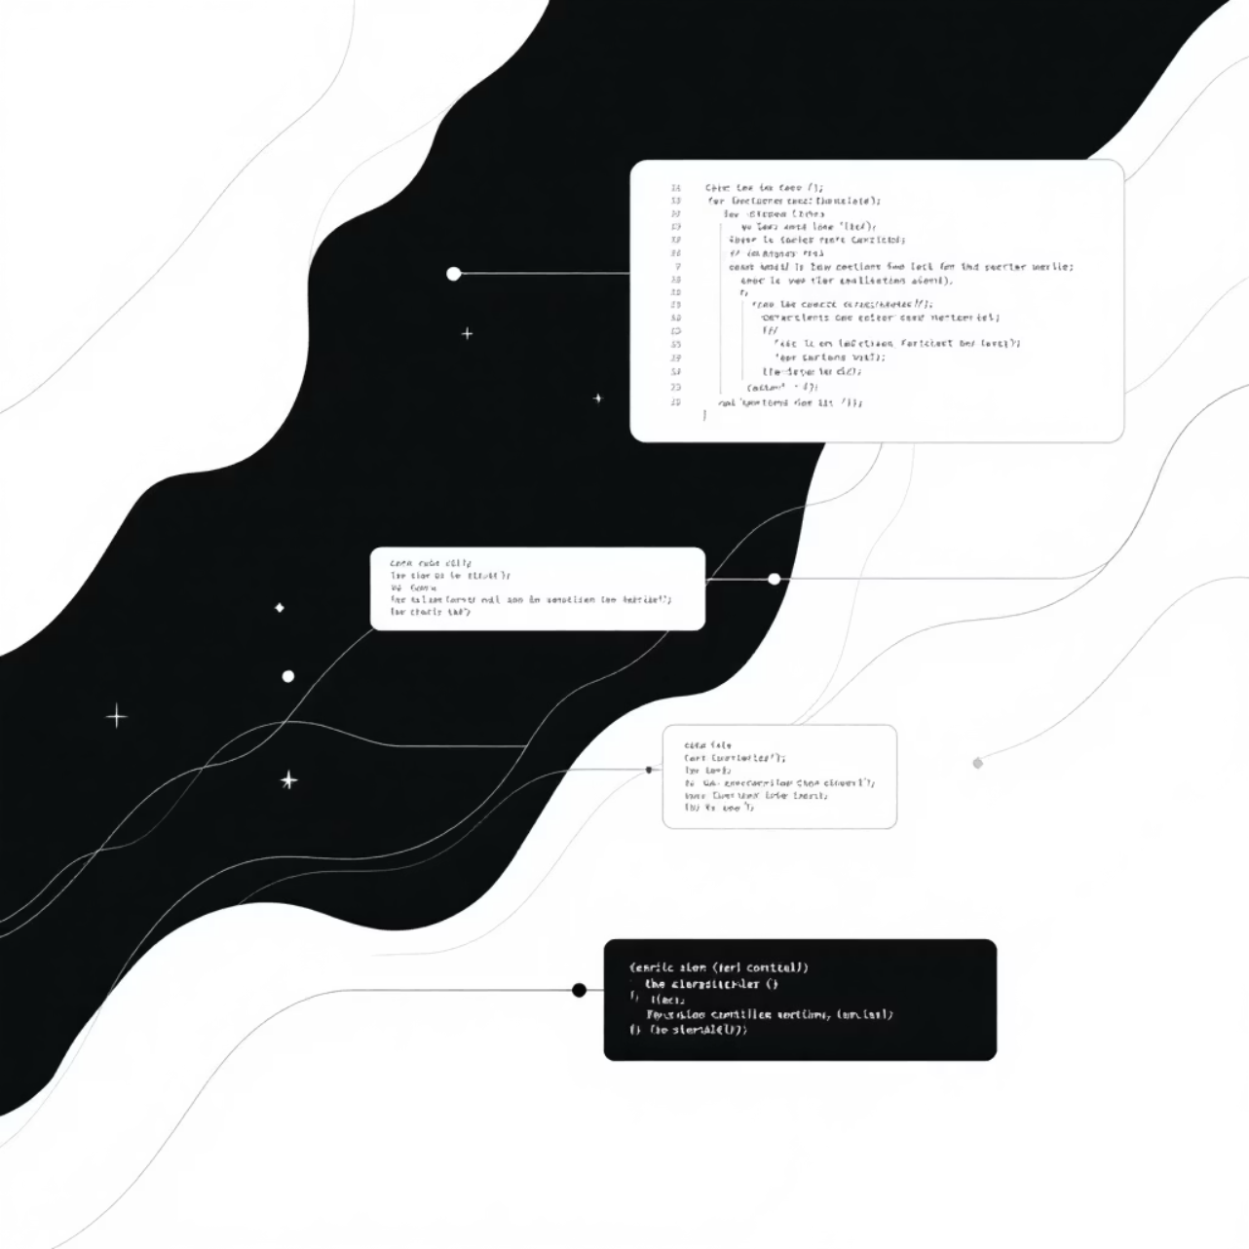
CHAPTER 1
What is Git?
Git is a version control system that helps you track changes in your code over time. Think of it as a time machine for your projects – you can save snapshots of your work and go back to any previous version whenever you need.
Whether you're working alone or with a team, Git keeps your code organized and safe.

Slide 3
Git vs GitHub: What's the Difference?
Git
GitHub
A tool installed on your computer that tracks code changes locally
An online platform where you can store and share your Git projects
Works offline
Cloud-based storage
Saves your project history
Collaboration features
Manages versions
Portfolio showcase

Slide 4
CHAPTER 2
Basic Git Setup Commands
Before you start using Git, you need to configure it with your information. These commands only need to be run once on your computer.
1
2
Check if Git is installed
Set your name
git --version
git config --global user.name "Your Name"
Displays the Git version on your system
This name appears in your commit history
3
4
Set your email
View your settings
git config --global user.email "you@example.com"
git config --list
Use the same email as your GitHub account
Shows all your Git configuration settings

Slide 5


Repository Commands
A repository (or "repo") is like a project folder that Git tracks. Here's how to create or copy one.
Start a new repository
git init
Creates a new Git repository in your current folder. Use this when starting a new project from scratch.
Copy an existing repository
git clone <url>
Downloads a repository from GitHub to your computer. Perfect for contributing to existing projects.

Slide 6
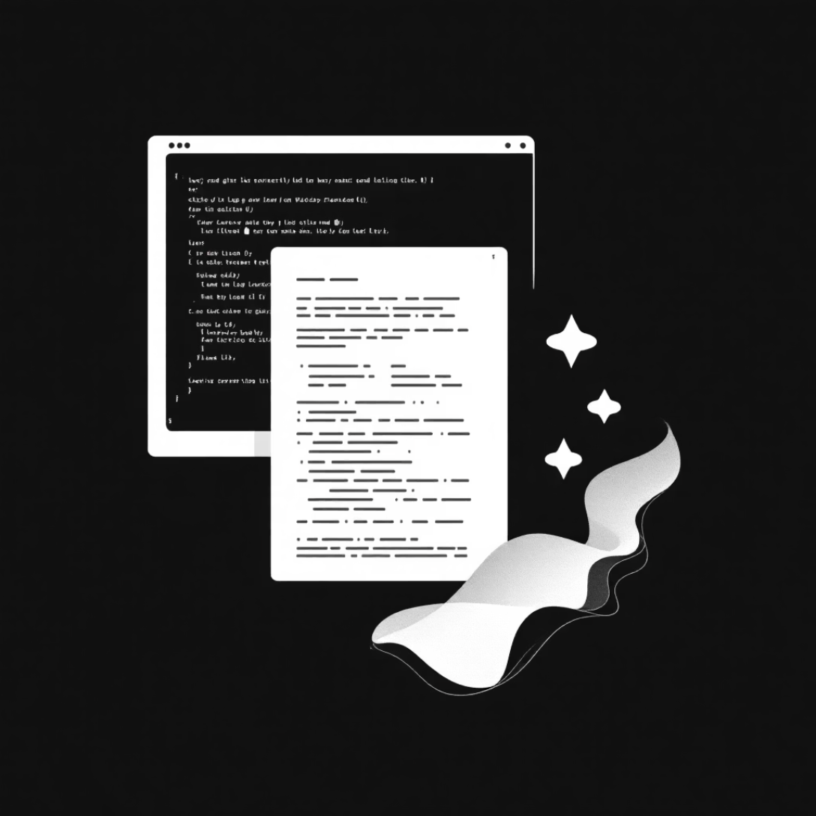
CHAPTER 3
Checking Status & History
These commands help you understand what's happening in your repository right now and what happened in the past.
01
Check current status
git status
Shows which files have changed and which are ready to commit
02
View commit history
git log
Displays detailed history of all commits
03
View simplified history
git log --oneline
Shows a compact, easy-to-read version of your commit history

Slide 7




Adding & Committing Files
Committing is like taking a snapshot of your project. First you add files to prepare them, then you commit to save the snapshot.
Add specific file
Add all files
Commit changes
git add filename
git add .
git commit -m "message"
Stages one file for commit
Stages all changed files at once
Saves your snapshot with a descriptive message
Pro tip: Write clear commit messages like "Add login feature" or "Fix navigation bug" so you can understand your changes later.

Slide 8

Connecting to GitHub
Once you have a local repository, connect it to GitHub so you can back up your work and share it with others.
1
Link to GitHub repository
git remote add origin <url>
Connects your local repo to a GitHub repository. The URL comes from GitHub when you create a new repo there.
2
Rename default branch
git branch -M main
Changes your branch name to "main" (GitHub's default). This ensures compatibility with GitHub.

Slide 9
CHAPTER 4
Push & Pull Commands
These commands sync your local work with GitHub – pushing uploads your changes, pulling downloads updates.
Upload to GitHub
Download from GitHub
git push origin main
git pull origin main
Sends your committed changes from your computer to GitHub
Gets the latest changes from GitHub to your computer
Backs up your work
Updates your local copy
Shares with team
Gets teammates' work
Updates online version
Keeps you in sync

Slide 10
CHAPTER 5
Branch Commands
Branches let you work on new features without affecting your main code. Think of them as parallel universes for your project!
1
2
List branches
Create new branch
git branch
git branch branch-name
Shows all branches in your repository
Makes a new branch but doesn't switch to it
3
4
Switch branches
Create and switch
git checkout branch-name
git checkout -b branch-name
Moves you to a different branch
Creates a new branch and switches to it immediately
5
6
Merge branches
Delete branch
git merge branch-name
git branch -d branch-name
Combines changes from another branch into your current branch
Removes a branch you no longer need

